Slide 1
Project Recovery (MGMT-6060)
Project Topic: Ottawa-Windsor Express Rail
Team Members (Team 09)
M M Navid Al Adnan (1169345)
Rona R. Bautista (0897048)
Hitenkumar B. Patel (1120292)
Ronisha Pokharel (1187263)
Gihan Shamike Liyanage (1142109)
Disclaimer: This project is created for academic purposes only. It is not sponsored by or reviewed by any real organizations discussed in this report.

Slide 2
Executive Summary Driving Economic Prosperity Along Ottawa to Windsor
Key Partners | Government Authorities Railway Construction Companies Technology Providers Maintenance Service Provider
Key Activities | Infrastructure Development Train Manufacturing Operations and Maintenance Technology Integration
Key Resources | High Speed Rail Infrastructure Skilled Workforce Technology and innovation High quality Machinery
Value Proposition | Environmental Benefit Less Time Consuming

Slide 3
Executive Summary Driving Economic Prosperity Along Ottawa to Windsor
Customer Relationship | Customer Service Loyalty Program Safety Assurance
Channels | Online Ticketing Platforms Station Ticket Counters Marketing and Advertising
Cost Structure | Fixed Cost: $ 30 Billion (increased from 25 Billion because of changes in project) Variable: $ 700 million/year
Revenue Streams | Ticket Sale Rent from Stations from Coffee Shops and other shops Revenue from advertisement Estimated revenue is $800 million/year

Slide 4
Executive Summary Driving Economic Prosperity Along Ottawa to Windsor
New additional details Added | PESTLE Analysis Earned Value Management Updated Project Stakeholder and our requirements Updated Project Technology Updated Project Benefits in details Updated Project Cash Flow Updated WBS Request for Approval by the Steering Committee

Slide 5
Project Changes
Cost increased from $25 Billion to $30 Billion by adding a 20% Management Reserve. We added a 10% Contingency reserve in major deliverable levels previously and came up with a $25 Billion cost but that was not shown in WBS. We have revised our WBS accordingly this time.
The project timeline increased from 4650 days (13 Years) to 6495 days (18 Years) by adding contingency reserve days in the major deliverable levels. Also, the project’s construction is now divided into two phases, which causes schedule time to increase. We have revised our WBS accordingly which is attached to the submission.
Provided a detailed clarification of the project scope, explicitly specifying whether it involves a dual-track railway. Clearly outline the cities the railway will pass through and identify any major stops or hubs.
Enhanced the WBS to include a detailed schedule that outlines the different stages of the project.
Included concept diagrams that illustrate how the completed railway will transform the cities it passes through.
Integrated a time buffer into the project schedule to account for potential delays, unexpected challenges, and changes in the construction timeline.

Slide 6
Company Description
Rail Transportation | About Canada Rail
A Vital Pillar of Canada's Infrastructure | Established: 1977 Headquarters: Montreal Key Leadership: Françoise Bertrand (Chairman) Mario Peloquin (CEO)
Vision Statement
Connecting Communities, Driving Progress.
Mission Statement | Core Values
To provide a seamless and efficient rail transportation network that fosters economic growth, enhances connectivity, and promotes sustainability. | Excellence: Striving for the highest standards in service and operations. Innovation: Embracing cutting-edge technologies for sustainable transportation. Collaboration: Fostering partnerships for mutual growth and community development. Safety: Prioritizing the well-being of passengers, employees, and the public.
Reference:
Canada, G. o. (n.d.). Rail transportation. Retrieved from tc.canada.ca
https://tc.canada.ca/en/rail-transportation

Slide 7
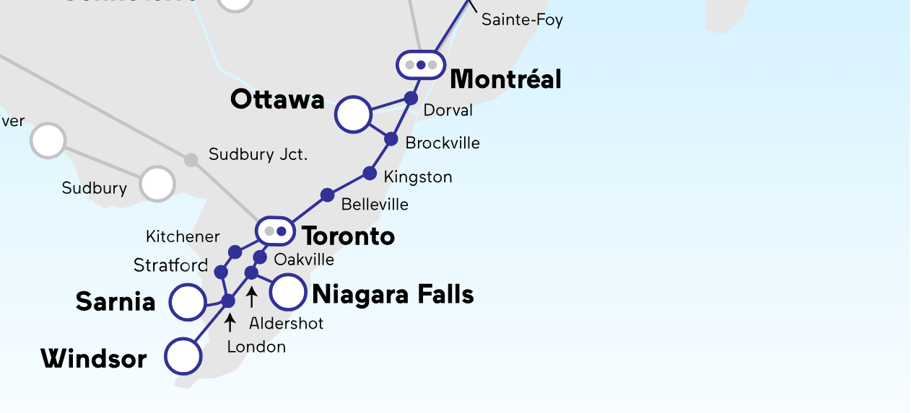
Bullet Train Route
Sources: - https://www.viarail.ca/en/explore-our-destinations/trains/ontario-and-quebec

Slide 8
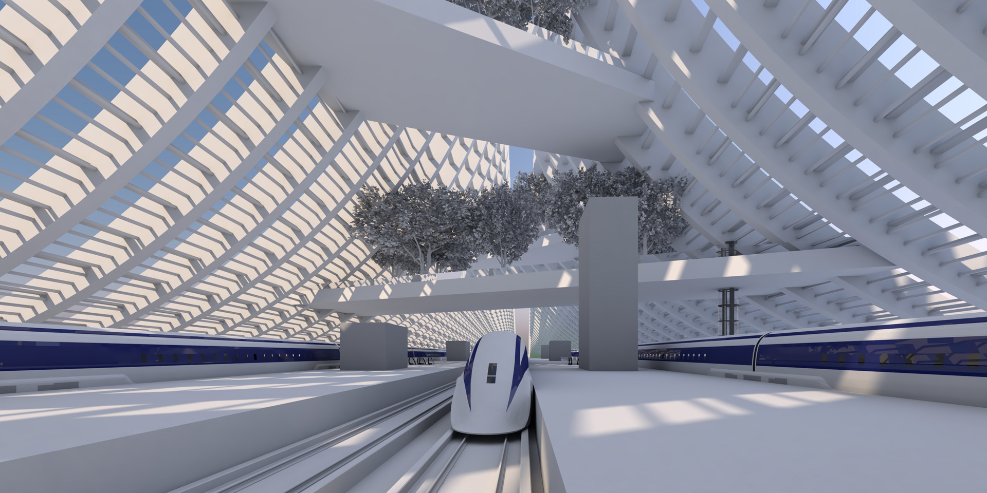
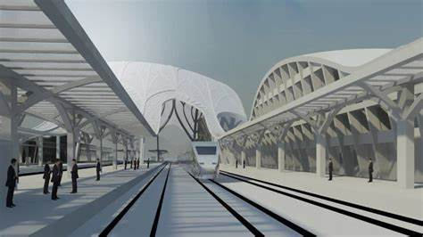
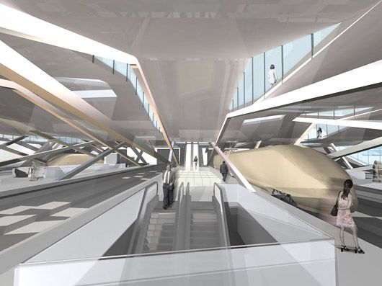
How’s London Bullet Train going to be look like
Sources: -
Studio Axis. 2022. Thailand High Speed Rail – Pattaya Station
https://studioaxis.com/project/thailand-high-speed-rail-pattaya-station-2/
Railway Technology. May 31, 2018. News. Otis France to provide escalators to SNCF French Rail
https://www.railway-technology.com/news/otis-france-provide-escalators-sncf-french-rail/
All Plan. March 2, 2022. Building Indonesia’s New High-Speed Rail Stations
https://blog.allplan.com/en/building-indonesias-new-high-speed-rail-stations

Slide 9
Project Objectives
Innovation
Product: Advanced High-Speed Mobility Ecosystem: Expand project scope to create a comprehensive high-speed mobility ecosystem, including trains, infrastructure, and interconnected transportation modes.
Service: Integrated Passenger Experience: Enhance passenger service with personalized in-cabin experiences, real-time journey optimization, and advanced accessibility options.
Technology: Sustainable Mobility Solutions: Implement cutting-edge technologies for sustainable mobility, such as energy-efficient propulsion systems and eco-friendly materials.
Process: AI-Driven Predictive Maintenance: Utilize AI for predictive maintenance to enhance reliability and safety of the high-speed rail system
Reference:
CALIFORNIA HIGH-SPEED TRAIN PROJECT . (n.d.-a). https://railroads.dot.gov/sites/fra.dot.gov/files/fra_net/2239/01.pdf

Slide 10
Project Objectives
Marketing
Meeting Market Needs: Identify and address specific market needs through in-depth market research.
Communicating Sustainability: Emphasize environmental benefits, positioning the high-speed rail system as a sustainable mode of transportation.
Enhanced Connectivity for Remote Working: Highlight the high-speed rail system as a facilitator of remote working by providing a comfortable and connected travel environment.
Smart City Integration: Communicate the project's role in contributing to smart city initiatives by reducing urban congestion and promoting sustainable urban development.
Cultural and Educational Experiences: Position the high-speed rail system as a gateway to cultural and educational exploration, promoting tourism and easy access to historical sites and educational institutions.
Reference:
CALIFORNIA HIGH-SPEED TRAIN PROJECT . (n.d.-a). https://railroads.dot.gov/sites/fra.dot.gov/files/fra_net/2239/01.pdf

Slide 11
Project Objectives
Affordable Housing Solutions: Promote the high-speed rail as a catalyst for decentralization, allowing residents to live in more affordable neighborhoods while maintaining accessibility to employment opportunities.
Digital Engagement and Community Involvement: Utilize digital platforms for engaging the community and potential passengers, fostering community involvement through feedback mechanisms.
Reference:
CALIFORNIA HIGH-SPEED TRAIN PROJECT . (n.d.-a). https://railroads.dot.gov/sites/fra.dot.gov/files/fra_net/2239/01.pdf

Slide 12
Expected Benefits – Economic Value
Increased Productivity and Innovation: The reduction in travel time and enhanced connectivity will contribute to increased productivity and encourage innovation in various sectors.
Supply Chain Optimization: The improved transportation network will optimize supply chain logistics, reducing lead times for the movement of goods, leading to cost savings and increased competitiveness.
Technology Transfer and Skill Development: The construction and operation of the high-speed rail system will necessitate the adoption of advanced technologies, leading to technology transfer and skill development.
Real Estate Development and Value Appreciation: Areas around high-speed rail stations are likely to experience increased real estate development and value appreciation, stimulating economic growth and attracting investment.
Global Business Opportunities: The improved connectivity can position the region as a hub for international business, attracting global companies and increasing foreign direct investment
Reference:
American Public Transportation Association. (2021, March 17). Benefits of high-speed rail for the United States. https://www.apta.com/research-technical-resources/high-speed-passenger-rail/benefits-of-high-speed-rail-for-the-united-states

Slide 13
Expected Benefits – Social
Health and Well-being Improvements: Reduced commuting times and stress associated with congestion can contribute to improvements in public health and well-being.
Educational Access and Collaboration: High-speed rail facilitates easier access to educational institutions, fostering collaboration between universities and research centers across regions.
Community Engagement and Cultural Diversity: The enhanced connectivity can promote community engagement and lead to a more diverse and culturally rich society.
Inclusive Economic Growth: The benefits of the high-speed rail project can be distributed more inclusively, ensuring that marginalized communities also experience positive impacts.
Tourism Experience Enhancement: The focus can be on enhancing the overall tourism experience, including developing cultural events, heritage preservation initiatives, and sustainable tourism practices
Reference:
American Public Transportation Association. (2021, March 17). Benefits of high-speed rail for the United States. https://www.apta.com/research-technical-resources/high-speed-passenger-rail/benefits-of-high-speed-rail-for-the-united-states/

Slide 14
Expected Benefits – Environmental Accountability
Renewable Energy Integration: An emphasis can be placed on integrating renewable energy sources into the rail system to further reduce the project's carbon footprint.
Biodiversity Conservation Initiatives: Conservation initiatives can be implemented to protect local biodiversity affected by the rail project, including habitat restoration programs and ecological monitoring.
Circular Economy Practices: Implementing circular economy practices can minimize waste generation during both the construction and operational phases.
Carbon Offsetting and Emission Reduction Programs: The project can engage in carbon offsetting programs and emission reduction initiatives to compensate for the environmental impact.
Public Awareness and Environmental Education: Establishing public awareness campaigns and environmental education programs can inform the community about the project's environmental initiatives.
Reference:
American Public Transportation Association. (2021, March 17). Benefits of high-speed rail for the United States. https://www.apta.com/research-technical-resources/high-speed-passenger-rail/benefits-of-high-speed-rail-for-the-united-states

Slide 15
PESTLE Analysis
Political:
Government Policies: Changes in government policies related to infrastructure development and transportation can impact the project.
Regulatory Environment: Compliance with federal, provincial, and municipal regulations related to construction, safety, and environmental standards.
Economic:
Funding and Financing: Availability of funding and financing options for the high-speed rail project.
Economic Conditions: Economic stability and growth rates, can affect the project's feasibility and financial viability.
Reference:
Transport Canada. July 4, 2023. Newswire Canada. Government Of Canada Announces Investment To Make Railways Safer While Reducing The Impacts Of Climate Change.
https://www.newswire.ca/news-releases/government-of-canada-announces-investment-to-make-railways-safer-while-reducing-the-impacts-of-climate-change-844086218.html
Railway Association of Canada. December 2, 2022. Blog. Canadian Rail A Driver Of Economic Growth
https://www.railcan.ca/blog/canadian-rail-a-driver-of-economic-growth/

Slide 16
PESTLE Analysis
Social:
Public Perception: Community attitudes and perceptions toward the high-speed rail project, including concerns about noise, disruptions, and benefits.
Demographic Factors: Population density and distribution, as well as factors influencing ridership.
Technological:
Innovation: Opportunities for technological advancements in high-speed rail construction and operation.
Integration: Compatibility with existing transportation infrastructure and technologies.
Reference:
CN. n.d. Delivering Responsibly. Community. Noise.
https://www.cn.ca/en/delivering-responsibly/community/noise
Cutric Marquee Project. n.d. Smart Rail Innovation Program 2022-2025
https://cutric-crituc.org/marquee-projects/smart-rail/

Slide 17
PESTLE Analysis
Legal:
Land Acquisition: Legal processes and challenges related to acquiring land and right-of-way for the rail route.
Environmental Regulations: Compliance with environmental laws and regulations, including impact assessments.
Environmental:
Ecological Impact: Potential effects on local ecosystems, wildlife, and natural resources.
Carbon Footprint: Addressing environmental sustainability and minimizing the project's carbon footprint.
Reference:
CN. August 15, 2022. CN Environmental Policy. Page 1.
www.cn.ca/cn-environment-policy-en
Railway Association of Canada. July 1, 2016. How Railways Can Be Part Of Canada’s Climate Change Solution. Pages 6-7.
www.railcan.ca/publications/how-railways-can-be-part-of-Canadas-climate-change-solution-en

Slide 18
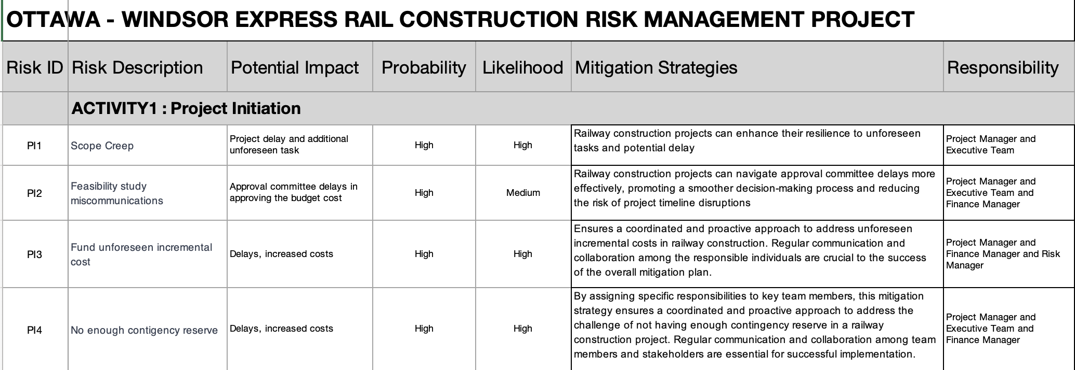
Risk Register
Reference:
Canadian Construction Association. 2021. Strength, Resilience, Sustainability.
https://www.cca-acc.com/wp-content/uploads/2021/03/Strength-resilience-sustainability-Full-Report-Final.pdf

Slide 19
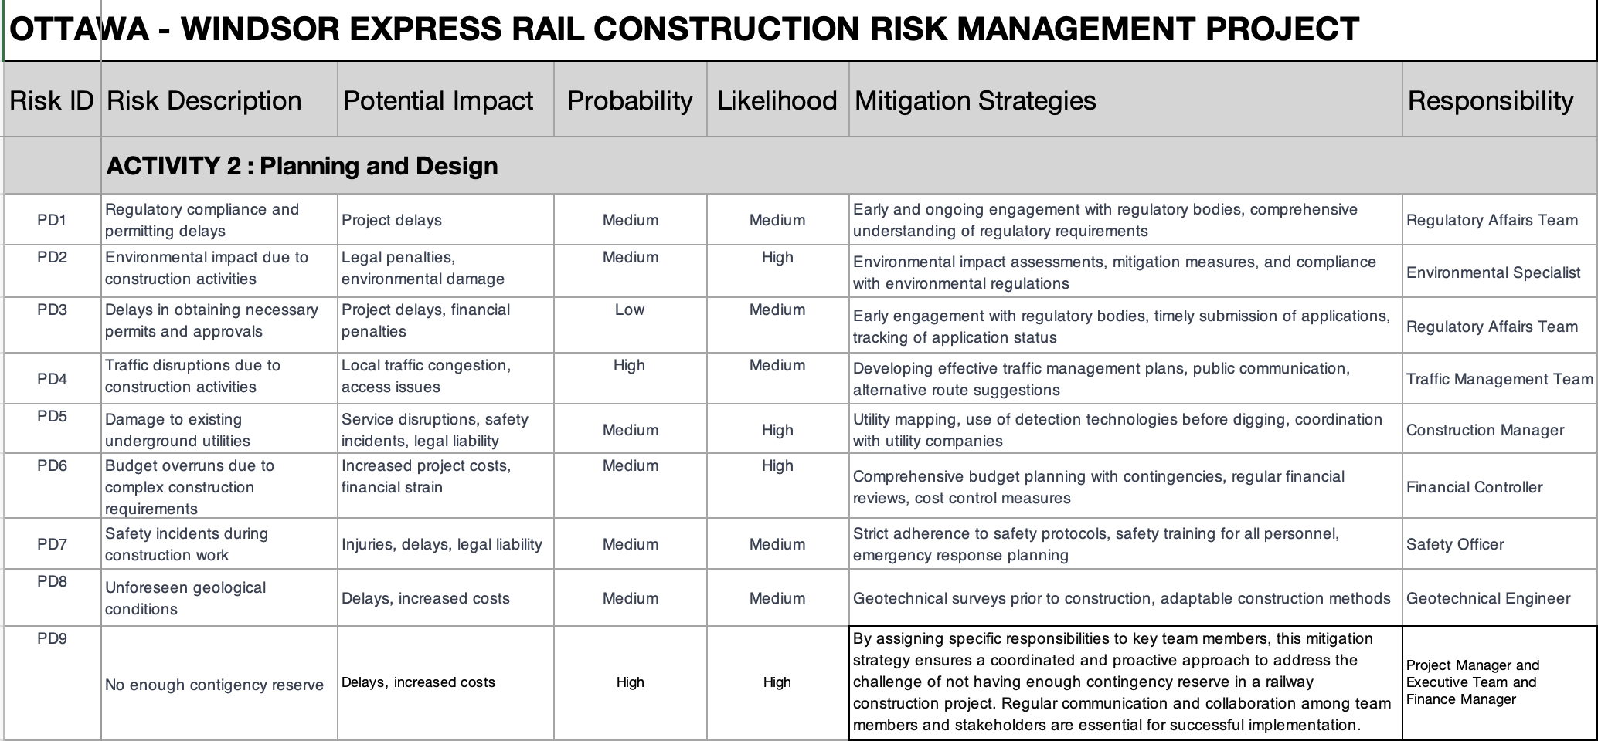
Risk Register
Reference:
Canadian Construction Association. 2021. Strength, Resilience, Sustainability.
https://www.cca-acc.com/wp-content/uploads/2021/03/Strength-resilience-sustainability-Full-Report-Final.pdf

Slide 20
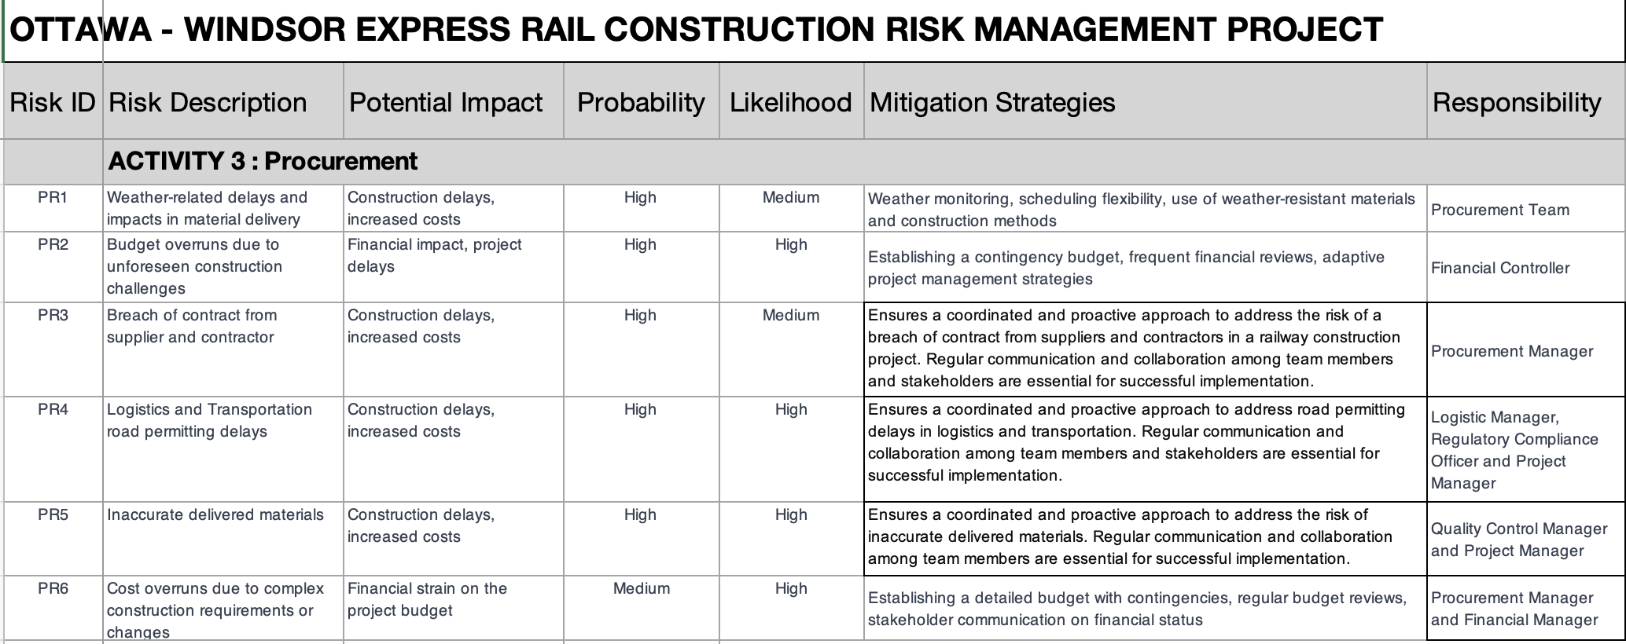
Risk Register
Reference:
Canadian Construction Association. 2021. Strength, Resilience, Sustainability.
https://www.cca-acc.com/wp-content/uploads/2021/03/Strength-resilience-sustainability-Full-Report-Final.pdf

Slide 21
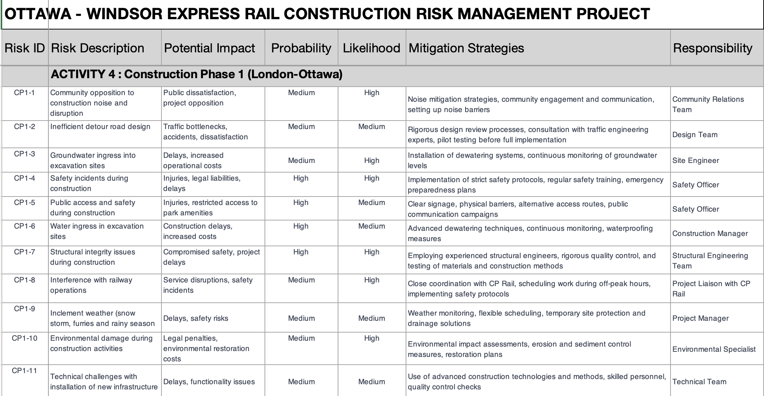
Risk Register
Reference:
Canadian Construction Association. 2021. Strength, Resilience, Sustainability.
https://www.cca-acc.com/wp-content/uploads/2021/03/Strength-resilience-sustainability-Full-Report-Final.pdf

Slide 22
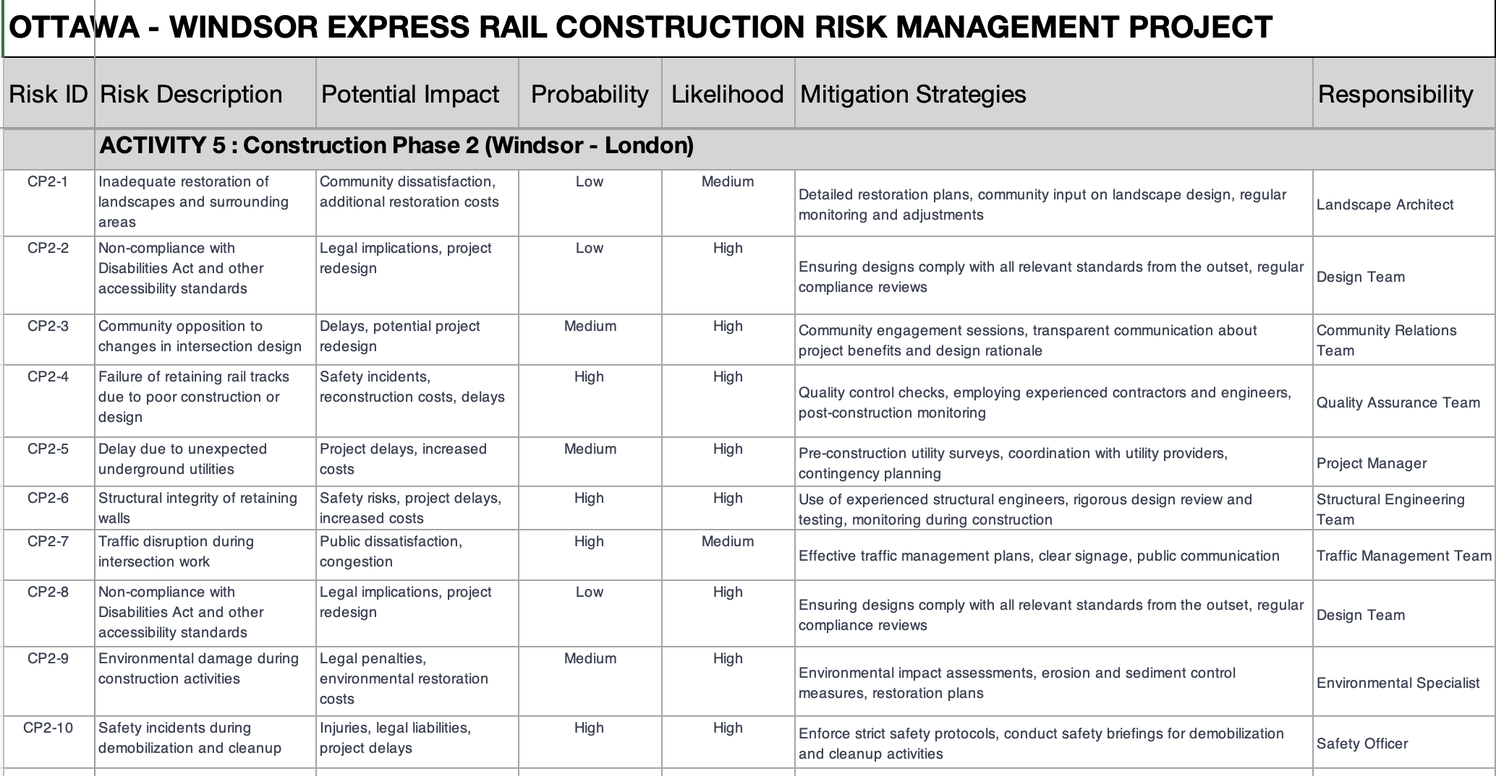
Risk Register
Reference:
Canadian Construction Association. 2021. Strength, Resilience, Sustainability.
https://www.cca-acc.com/wp-content/uploads/2021/03/Strength-resilience-sustainability-Full-Report-Final.pdf

Slide 23
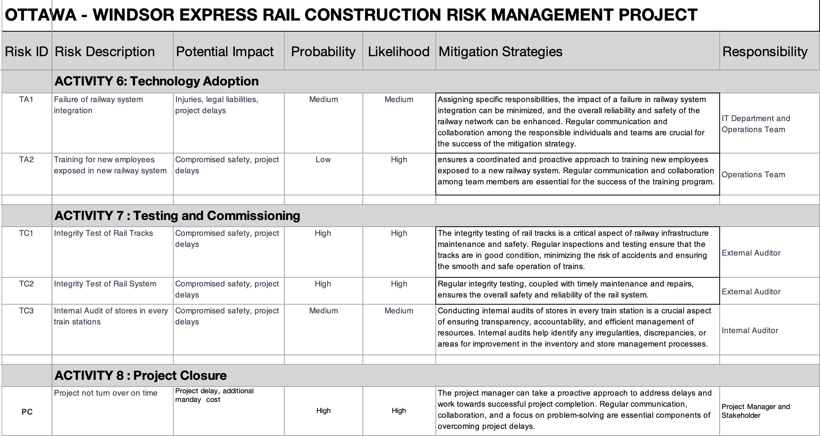
Risk Register
Reference:
Canadian Construction Association. 2021. Strength, Resilience, Sustainability.
https://www.cca-acc.com/wp-content/uploads/2021/03/Strength-resilience-sustainability-Full-Report-Final.pdf

Slide 24
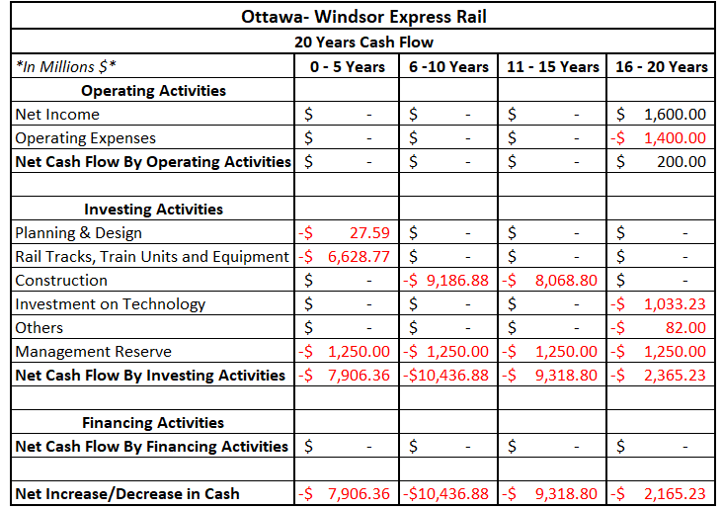
Project Cash Flows

Slide 25
Project Cash Flows
Cash Outflow:
Project Cost: We are going to renovate the existing rail tracks which will support the bullet train. We are also going to renovate the train station to accommodate bullet train operation. Also, there are other items like- the purchase of bullet train units, equipment, technology, etc. The estimated project cost will be around 25 Billion Canadian Dollars including contingency reserve. There is another project, but it is covering Toronto to Montreal, and it is estimated to be $21 Billion (Bien, Iqbal, Li, Stecher, & Manger). Since the distance is 100km more in our project, we are estimating the cost to be more than other Toronto-Montreal Projects. Also, we have added 20% management reserve and distributed the amount in the 18 years of the project. Including management reserve, the cost of the project is $30 Billion.
Funding: Canadian National Railway is going to conduct the projects and therefore, the project will be funded by the federal government. So, no outside financing is required for this project.
Operating Expense: Operating expense is estimated to be around $700 Million per year.
Cash Inflow:
Revenue: We are estimating the annual revenue to be $800 Million per year. The Toronto-Montreal Express rail project is expected to yield $20 Billion in the span of 60 Years ((High-Speed Rail, n.d.). We are also expecting the same for our project. We have shown two years of operating activities in our cash flow statement.
Reference:
Bien, P., Iqbal, S., Li, A., Stecher, I., & Manger, M. (n.d.). Global Economic Policy Lab. Retrieved from High-Speed Rail: Toronto – Montreal
High-Speed Rail. (n.d.). Retrieved from OFA: https://ofa.on.ca/issues/high-speed-rail/

Slide 26
Earned Value Management
 | In Million $
EV | $27.59
PV | $27.59
AC | $27.59
EAC | $30,027.27

Slide 27
Preliminary Stakeholder Register
The Government of Canada has established the High-Frequency Rail (HFR) in 2016.
Transport Canada – Project Authority leading the project (on behalf of the Minister of Transport).
Members (supported by the Department of Justice)
Infrastructure Canada
Public Services
Procurement Canada
VIA HFR (VIA Rail Subsidiary to support High Frequency Rail)
Additional stakeholders are
Landowners | Labor Unions | Indigenous Communities
Local Communities | Utility Companies | Businesses and Industries
Environmental Groups | Tourism Organizations | Passenger Advocacy Groups
Emergency Services | Rail Operators
Reference:
Borealis. n.d. The Challenge. Building on Lessons Learned.
https://www.boreal-is.com/use-case-rail-industry/

Slide 28
Preliminary Stakeholder Register
Stakeholder engagement can help the organization achieve better outcomes, whether it is education, connection, engagement or profit.
Empower people – Get stakeholders involved in the decision-making process.
Create sustainable change – Engaged stakeholders help inform decisions and provide the support that the organization needs for long-term sustainability.
Build relationships – Create mutually beneficial relationships, build on existing relationships or foster new ones.
Build a better organization – Engaging with stakeholders can bring important issues to light and encourage the organization to develop corporate social responsibility.
Increase success – Engaging influential groups and turning them into supporters and advocates can boost the organization’s chances of success.
Educate – Stakeholders can be a valuable source of information for the organization, and they may learn something from it.
Reference:
Hendricks, A. n.d. Simply Stakeholders. The Importance of Stakeholders: Identifying and Prioritizing Stakeholder Engagement.
https://simplystakeholders.com/the-importance-of-stakeholders/

Slide 29
Preliminary Stakeholder Register
As the Ottawa-Windsor Express Rail project progresses, effective stakeholder engagement is paramount for success. We have identified various stakeholder needs and devised solutions to address them, ensuring transparent communication and collaboration throughout the project lifecycle.
Stakeholder Needs and Solutions:
Central Registry Establishment: Develop a comprehensive database to track stakeholder involvement.
Unified Stakeholder Information: Integrate data into a single platform for streamlined communication.
Mapping Stakeholder Influence and Concerns: Use mapping tools to understand affiliations and tailor engagement strategies.
Real-Time Reporting for Management: Provide timely updates to management for informed decision-making.
Reference:
Borealis. n.d. Stakeholder Engagement Platform. How To Engage Stakeholders And Strengthen Your Strategy
https://www.boreal-is.com/modules/stakeholder-engagement

Slide 30
Preliminary Stakeholder Register
Stakeholder | What They Will Receive from the Project | What the Project Will Receive from Them
Government | Improved transportation infrastructure | Funding, regulatory approvals, support
Local Communities | Enhanced connectivity, potential economic opportunities | Input, support, feedback on local impacts
Environmental Groups | Mitigation of environmental impacts, sustainable practices | Expertise, guidance on environmental stewardship
Emergency Services | Enhanced emergency response capabilities | Collaboration, support for emergency planning
Labor Unions | Job opportunities, fair labor practices | Labor support, collaboration
Utility Companies | Infrastructure coordination, minimal disruptions | Collaboration, support for utility relocation
Tourism Organizations | Increased traffic, economic growth | Promotion, tourism collaboration
Reference:
Borealis. n.d. Stakeholder Engagement Platform. How To Engage Stakeholders And Strengthen Your Strategy
https://www.boreal-is.com/modules/stakeholder-engagement

Slide 31
Required Resources - People Involve
Stakeholders | These are the group of people that overall approved the whole project, from the requirement, design, initiation and closing of the project.
PMO and Team | Professionals who organize, plan, and execute projects while working within restraints like budgets and schedules. Project managers lead entire teams, define project goals, communicate with stakeholders, and see a project through to its closure.
HSE Team | Collaborate with law enforcement agencies to ensure security measures are in place.
R&D Team | Develop detailed engineering plans for every aspect of the project, including track alignment, station layouts, bridges, tunnels, signaling systems, and power supply.
Procurement | Creating bidding documents for suppliers and contractors.
Reference:
Staff, C. November 29, 2023. Cousera. What Is A Project Manager? A Career Guide.
https://www.coursera.org/articles/what-is-project-manager
Jain, S. Aug. 12, 2023. Medium. “Forging the Path: The Construction of Bullet Train Tracks”
https://medium.com/@samarthjain/forging-the-path-the-construction-of-bullet-train-tracks-d2099a0cd11c

Slide 32
Required Resources - People Involve
Logistics and Warehouse Team | Initiate transportation and proper storage of raw and finished products.
TL and Laborers | Ground workers.
IT Team | IT is also used to improve operations, and in a way, it is also linked to scheduling. Optimization can go in several directions: better train control, dispatching, or customer information system.
3rd Party Testing Commissioning Team | Conduct a series of tests to ensure the safety and functionality of the infrastructure, signalling systems, and trains.
Reference:
Staff, C. November 29, 2023. Cousera. What Is A Project Manager? A Career Guide.
https://www.coursera.org/articles/what-is-project-manager#

Slide 33
Required Resources – Physical Equipment
Railway Infrastructure Upgrades: | Track Maintenance Equipment: Track Components: Bridge and Tunnel Renovation: | Track-laying machines, ballast regulators, tamping machines. Rails, ties, ballast, fastening systems. Equipment for strengthening bridges, tunnel repairs.
Rolling Stock & Maintenance Facilities: | Rolling Stock Refurbishment: Depot and Workshop Upgrades: | Refurbishing locomotives, passenger cars. Modifications for enhanced maintenance.
Safety & Control Systems: | Signaling and Control System Updates: Safety Equipment Maintenance: | Higher speed adaptations. Barrier replacement, upgrades.
Communication & Control Systems: | Train Control System Enhancements: Communication Infrastructure: | Modern technology integration. Network upgrades.
Construction & Utility Equipment: | Construction Machinery: Utility Upgrades: | Earthmoving equipment. Relocation equipment, materials.
Station Upgrades: | Station Renovation: Ticketing and Passenger Services: | Accessibility improvements, amenities. Modern installations.
Testing & Measurement Tools: | Track Inspection Equipment: Performance Testing Equipment Gauges and Calibrating Equipment: | Geometry measurement tools. Evaluation instruments Precision measurement tools.
Reference:
Wikipedia. n.d. Railway Track
https://en.wikipedia.org/wiki/Railway_track/

Slide 34
Required Resources – Physical Equipment
Environmental Mitigation Equipment: | Erosion Control Measures: Noise and Vibration Reduction: | Materials for environmental protection. Sound barriers, dampening materials.
Emergency Response Resources: | Emergency Response Equipment: | Firefighting gear, first aid kits.
Additional Resources: | Land Properties: Construction Materials: Heavy Equipment: | Warehouses, offices, temporary on-site facilities. Steel, frames, beams, wooden materials. Mobile cranes, forklifts, trucks, locomotives, hi-rail vehicles, buggies, gondolas.
Reference:
Wikipedia. n.d. Railway Track
https://en.wikipedia.org/wiki/Railway_track/

Slide 35
Required Resources - Time
The old railway construction began in 1881 and took four years to complete in 1885. When was the Canadian Pacific Railway completed? On November 7, 1885, the "Last Spike" was driven at Craigellachie in Eagle Pass, British Columbia, to meet the line to the Pacific coast.
Based on WBS a High-Speed Railway from Windsor to Ottawa may take, 6495 Days to complete this project is 16 to 17 years in the making. From conceptualization, planning, approvals, execution, testing and commissioning and finally turn-over to the client.
Project Initiation | 300 Days
Design and Engineering | 405 Days
Construction and Infrastructure Upgrades | 3990 Days
Technology Adaption | 240 Days
Testing and Commissioning | 300 Days
Monitoring and Evaluation | 210 Days | Total 6495 Days
Reference:
Camilleri, C. Mar. 2, 2023. Canadian Train Vacations. Canadian Pacific Railways Facts
https://canadiantrainvacations.com/blog/canadian-pacific-railway-facts#

Slide 36
Required Resources – Funding
Transport Canada’s Rail Safety Improvement Program (RSIP) provides funding for projects that improve infrastructure or propose research or new technologies to increase safety at grade crossings and along rail lines or that address or prevent the impact of climate change and extreme weather along rail lines. Projects that increase public confidence in Canada’s rail transportation system or education and awareness about rail safety issues are also funded.
Initial Investment: | Capital Investment & Land Acquisition | $6,656,360,000.00
Infrastructure Upgrades: | Track Rehabilitation & Station Renovations, Communication and Control Systems | $18,288,913,000.00
Environmental Mitigation: | Environmental Impact Assessments Green Technologies | $450,000,000.00
Contingency Fund: | Reserve Fund & Cost Overrun Mitigation | $1,500,000,000.00
Total Budget: | Government & Private investments | $25,027,274,306.00
Reference:
Government of Canada. n.d. Rail Safety Improvement Program
https://tc.canada.ca/en/programs/funding-programs/rail-safety-improvement-program

Slide 37
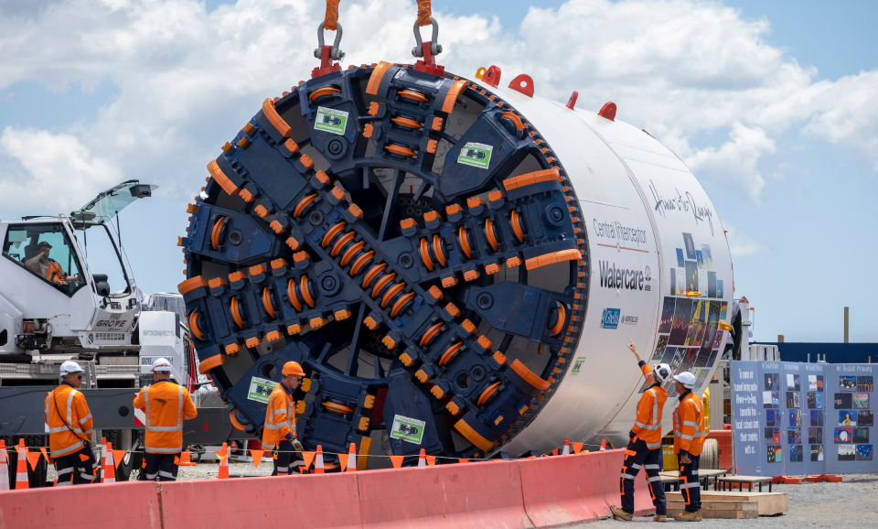
Preliminary Description of Any Technology
Design and Planning:
Detailed possibility studies are carried out to evaluate the project's feasibility before construction, considering variables such as cost, environmental impact, and route selection.
The route is planned by engineers considering variables like topography, population density, and the state of the infrastructure. High-speed trains need straight tracks with mild curves.
Construction Equipment:
Generally, TBMs are utilized for tunnelling. These enormous devices are capable of boring tunnels with little disturbance to the surface through rock and dirt. The tracks are precisely laid and aligned using specialized machinery. The purpose of high-speed rail tracks is to provide efficient, stable, and smooth transport. The need for bridges and viaducts may arise from the topography. These raised constructions are built with specialized machinery.
Preparation of the land involves the employment of excavators, bulldozers, and other earthmoving equipment, particularly in regions where levelling tracks are necessary. For the construction of the tracks, stations, and other structures, high-quality concrete is essential. Large volumes of concrete are produced using batch facilities.
Reference:
Jain, S. Aug. 12, 2023. Medium. “Forging the Path: The Construction of Bullet Train Tracks”
https://medium.com/@samarthjain/forging-the-path-the-construction-of-bullet-train-tracks-d2099a0cd11c

Slide 38
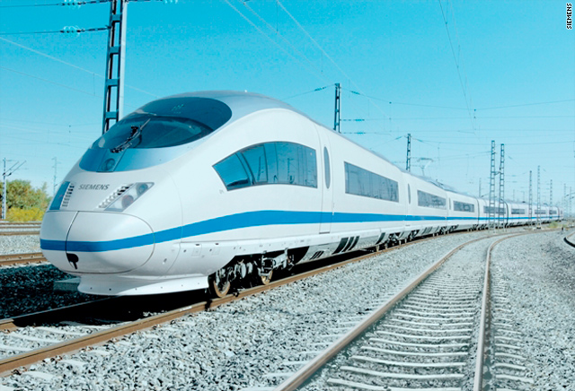
Preliminary Description of Any Technology
Infrastructure and structure:
The speed and volume of passengers are accommodated in the architecture of high-speed rail stations. Platforms, ticketing areas, security, and frequently commercial areas are among them. These are made to guarantee a safe and easy journey. Bridges must endure high-speed loads and environmental conditions, while tunnels can need ventilation mechanisms.
Technology and System:
To ensure both safety and effectiveness, modern train control systems regulate the speed and spacing of trains. Signaling and communication systems fall under this category.
Advanced technology such as regenerative braking systems, tilting mechanisms, and aerodynamic designs are featured in high-speed trains. Power supply systems, which frequently make use of extra rails or overhead wiring, are necessary for electrified high-speed rail lines. The general design incorporates several safety elements, including fire detection, emergency braking systems, and evacuation protocols.
Reference:
Jain, S. Aug. 12, 2023. Medium. “Forging the Path: The Construction of Bullet Train Tracks”
https://medium.com/@samarthjain/forging-the-path-the-construction-of-bullet-train-tracks-d2099a0cd11c

Slide 39
Preliminary Description of Any Technology
Technology and System:
Train Control Systems: Implementation of advanced train control technologies, such as Automatic Train Control (ATC) and Positive Train Control (PTC). These systems enhance safety, efficiency, and capacity on the rail network by providing real-time monitoring and control of train movements.
Communication and Signaling Systems: Deployment of modern communication networks and signaling systems for efficient train dispatching, scheduling, and passenger information dissemination. These systems improve reliability and responsiveness in railway operations.
GPS and GIS Technology: Integrated into construction equipment for precise site mapping, grading, and alignment. Global Positioning System (GPS) and Geographic Information System (GIS) technologies enhance accuracy and efficiency in earthmoving activities.
Telematics Systems: Installed in construction vehicles for real-time monitoring of equipment usage, fuel consumption, and maintenance scheduling. Telematics systems optimize fleet management and productivity on construction sites.
Reference:
Oct. 10, 2023. Federal Railroad Administration. “Positive Train Control (PTC)”
https://railroads.dot.gov/research-development/program-areas/train-control/ptc/positive-train-control-ptc

Slide 40
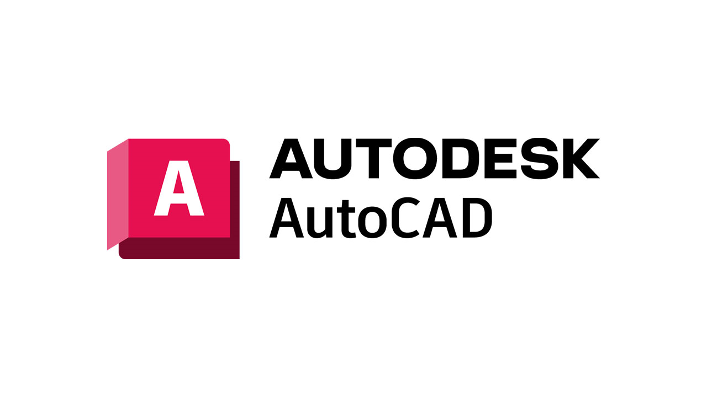
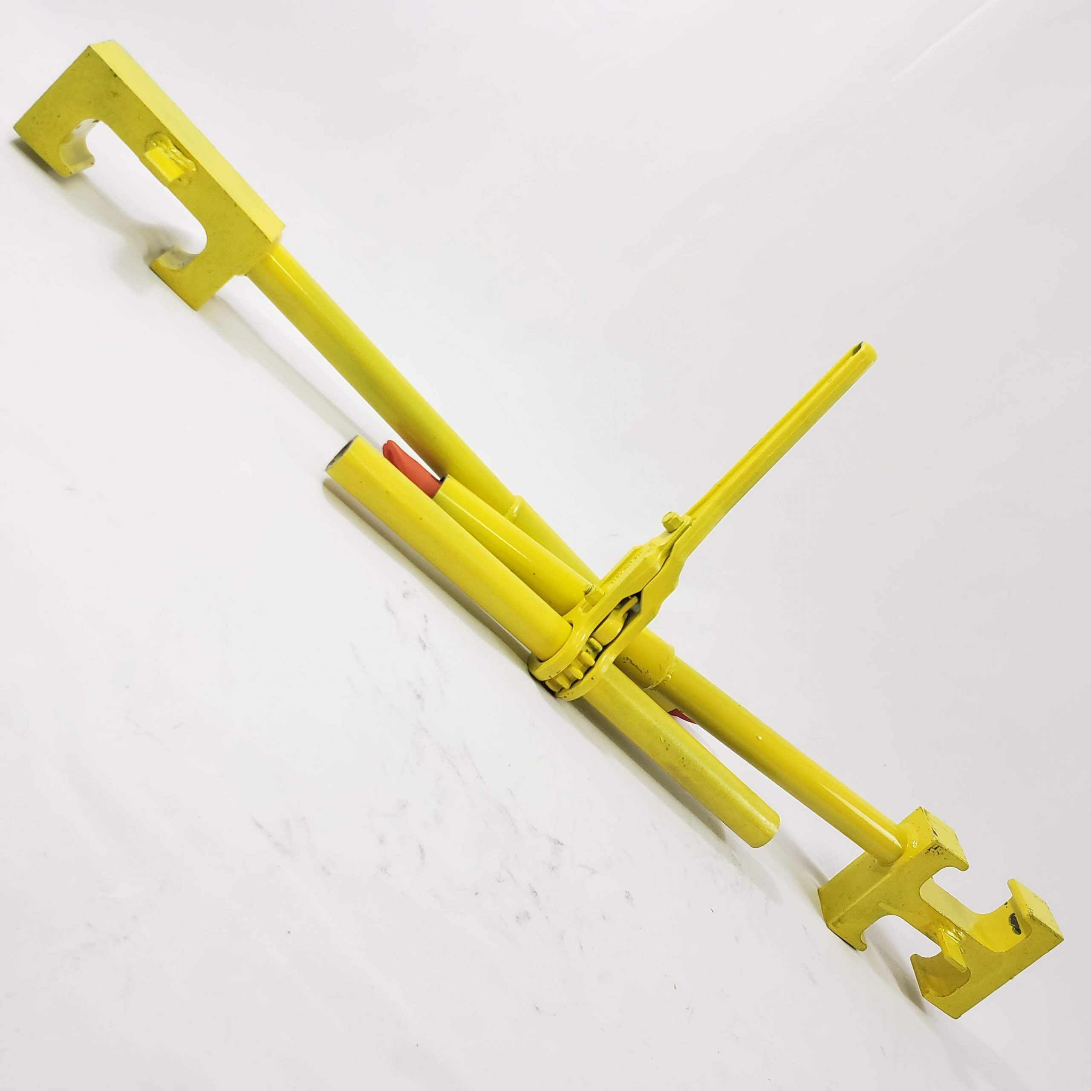
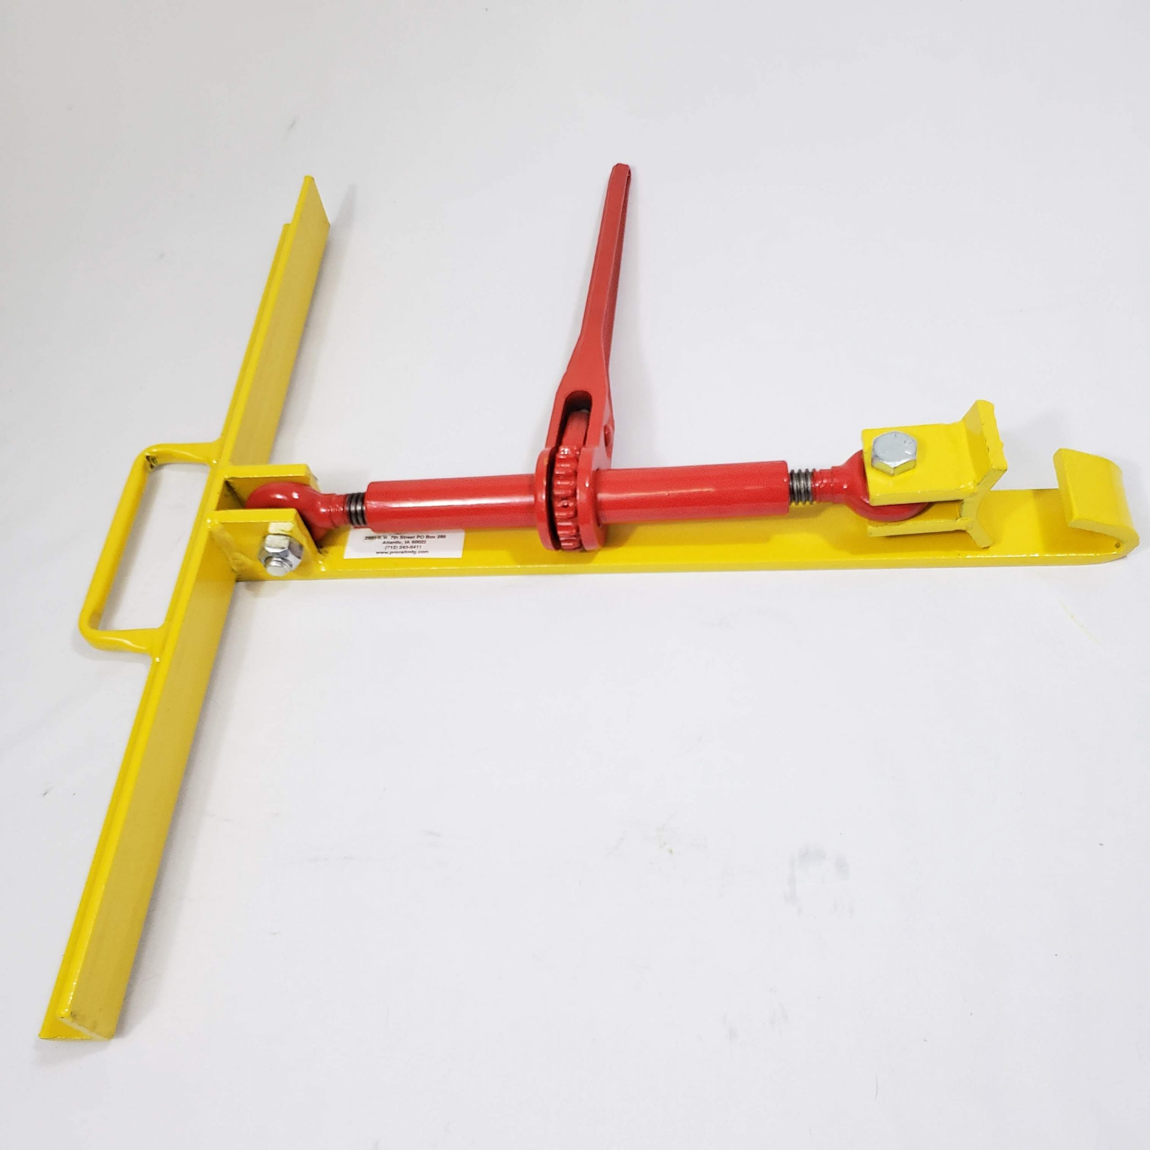

Preliminary Description of Any Technology
Hardware and Software:
Tracks, stations, and infrastructure are designed using computer-aided design (CAD) software.
Project management software (MS Project) is used for scheduling, resource allocation, and cooperation in the construction process management process.
Track alignment and levelling are precisely ensured using high-precision surveying equipment.
To ensure the safety of operations and to coordinate construction activities, advanced communication technologies are necessary.
Tunnel integrity is checked both during and after construction using specialized tools.
Reference:
Agico Group. Feb 10, 2017. How To Build A Railway Track?
http://www.railway-fasteners.com/news/how-to-build-a-railway-track.html

Slide 41
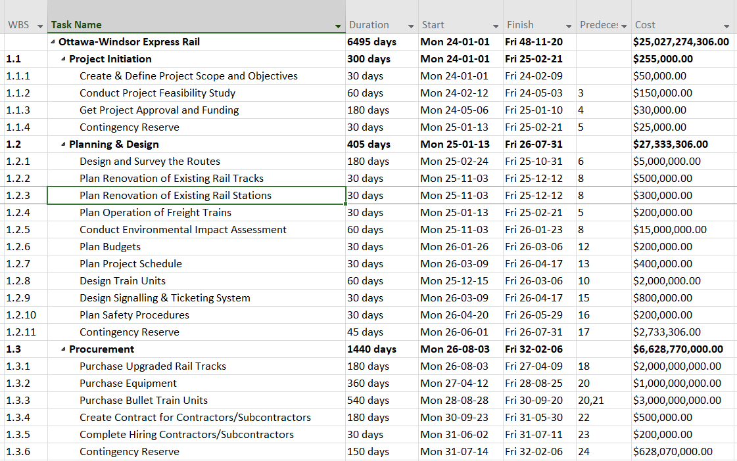
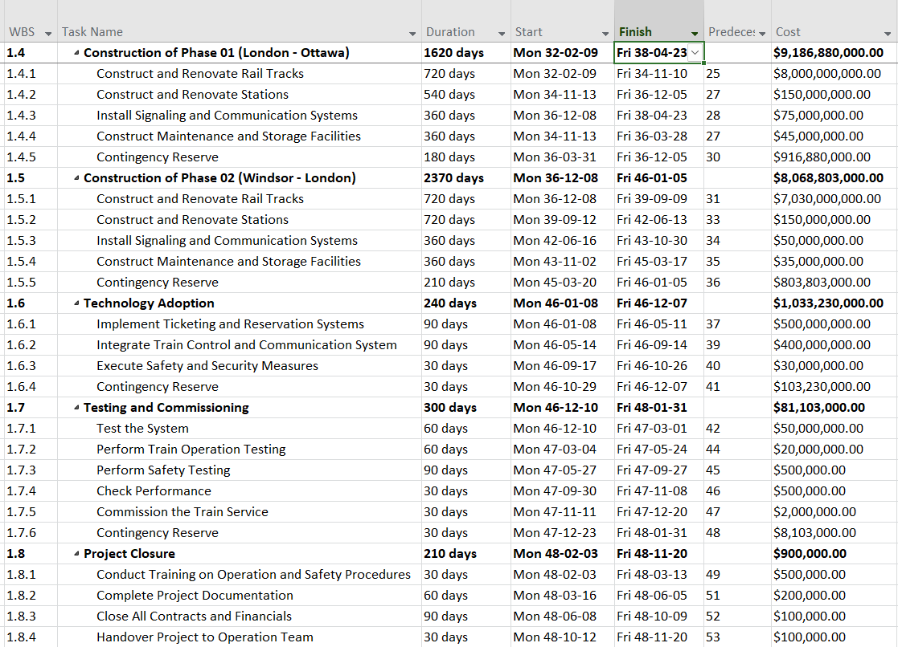
Work Breakdown Structure and Schedule
Reference:
High-speed rail. (n.d.). Retrieved from Ontario.ca
https://www.ontario.ca/page/high-speed-rail

Slide 42
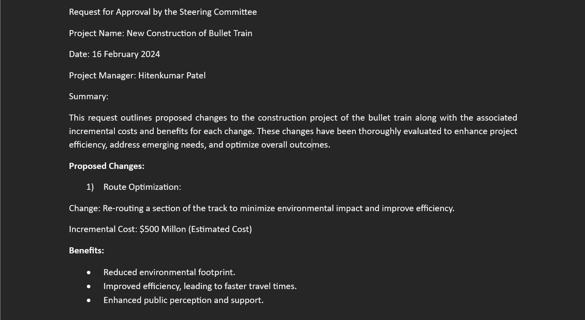
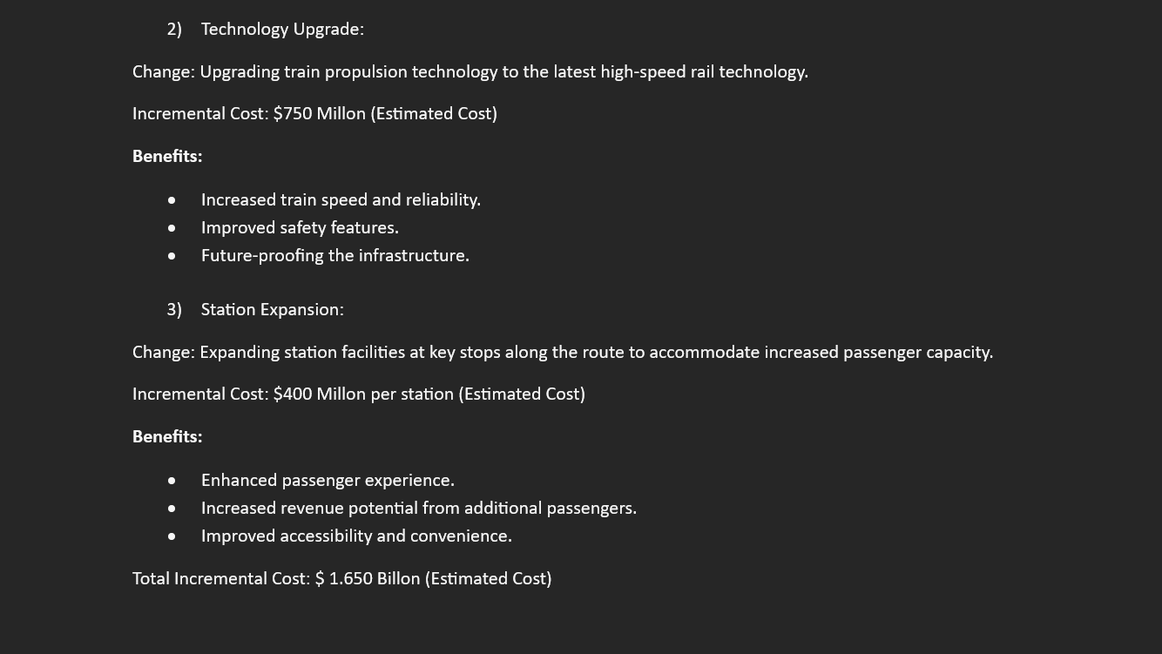
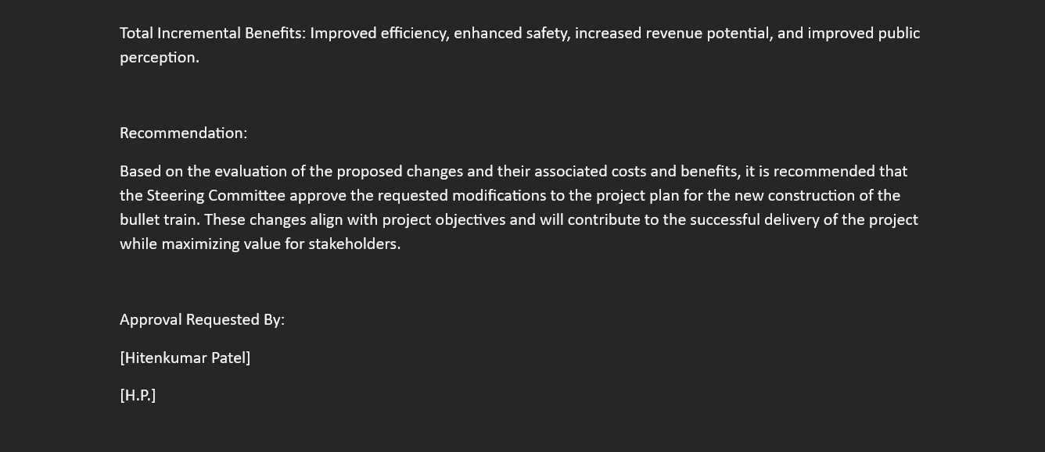
Request for Approval by the Steering Committee
See notes for the reference.
Notes:
Reference:
Harned, B. May 02, 2019. Managing Change Requests in Project Management, Retrieved from:
https://www.teamgantt.com/blog/managing-change-requests-in-project-management

Slide 43
Reference Summary
Canada, G. o. (n.d.). Rail transportation. Retrieved from tc.canada.ca
https://tc.canada.ca/en/rail-transportation
VIA Rail Canada. n.d. Ontario and Quebec.
https://www.viarail.ca/en/explore-our-destinations/trains/ontario-and-quebec
Studio Axis. 2022. Thailand High Speed Rail – Pattaya Station
https://studioaxis.com/project/thailand-high-speed-rail-pattaya-station-2/
Railway Technology. May 31, 2018. News. Otis France to provide escalators to SNCF French Rail
https://www.railway-technology.com/news/otis-france-provide-escalators-sncf-french-rail/
All Plan. March 2, 2022. Building Indonesia’s New High-Speed Rail Stations
https://blog.allplan.com/en/building-indonesias-new-high-speed-rail-stations
CALIFORNIA HIGH-SPEED TRAIN PROJECT. (n.d.-a). https://railroads.dot.gov/sites/fra.dot.gov/files/fra_net/2239/01.pdf
American Public Transportation Association. (2021, March 17). Benefits of high-speed rail for the United States.
https://www.apta.com/research-technical-resources/high-speed-passenger-rail/benefits-of-high-speed-rail-for-the-united-states
Transport Canada. July 4, 2023. Newswire Canada. Government Of Canada Announces Investment To Make Railways Safer While Reducing The Impacts Of Climate Change.
https://www.newswire.ca/news-releases/government-of-canada-announces-investment-to-make-railways-safer-while-reducing-the-impacts-of-climate-change-844086218.html
Railway Association of Canada. December 2, 2022. Blog. Canadian Rail A Driver Of Economic Growth
https://www.railcan.ca/blog/canadian-rail-a-driver-of-economic-growth/
CN. n.d. Delivering Responsibly. Community. Noise.
https://www.cn.ca/en/delivering-responsibly/community/noise

Slide 44
Reference Summary
Cutric Marquee Project. n.d. Smart Rail Innovation Program 2022-2025
https://cutric-crituc.org/marquee-projects/smart-rail/
CN. August 15, 2022. CN Environmental Policy. Page 1.
https://www.cn.ca/cn-environment-policy-en
Railway Association of Canada. July 1, 2016. How Railways Can Be Part Of Canada’s Climate Change Solution. Pages 6-7.
https://www.railcan.ca/publications/how-railways-can-be-part-of-Canadas-climate-change-solution-en
Canadian Construction Association. 2021. Strength, Resilience, Sustainability.
https://www.cca-acc.com/wp-content/uploads/2021/03/Strength-resilience-sustainability-Full-Report-Final.pdf
Bien, P., Iqbal, S., Li, A., Stecher, I., & Manger, M. (n.d.). Global Economic Policy Lab. Retrieved from High-Speed Rail: Toronto – Montreal High-Speed Rail. (n.d.). Retrieved from OFA.
https://ofa.on.ca/issues/high-speed-rail/
Borealis. n.d. The Challenge. Building on Lessons Learned.
https://www.boreal-is.com/use-case-rail-industry/
Hendricks, A. n.d. Simply Stakeholders. The Importance of Stakeholders: Identifying and Prioritizing Stakeholder Engagement.
https://simplystakeholders.com/the-importance-of-stakeholders/
Borealis. n.d. Stakeholder Engagement Platform. How To Engage Stakeholders And Strengthen Your Strategy
https://www.boreal-is.com/modules/stakeholder-engagement

Slide 45
Reference Summary
Staff, C. November 29, 2023. Cousera. What Is A Project Manager? A Career Guide.
https://www.coursera.org/articles/what-is-project-manager
Jain, S. Aug. 12, 2023. Medium. “Forging the Path: The Construction of Bullet Train Tracks”
https://medium.com/@samarthjain/forging-the-path-the-construction-of-bullet-train-tracks-d2099a0cd11c
Wikipedia. n.d. Railway Track
https://en.wikipedia.org/wiki/Railway_track/
Camilleri, C. Mar. 2, 2023. Canadian Train Vacations. Canadian Pacific Railways Facts
https://canadiantrainvacations.com/blog/canadian-pacific-railway-facts#
Government of Canada. n.d. Rail Safety Improvement Program
https://tc.canada.ca/en/programs/funding-programs/rail-safety-improvement-program
Federal Railroad Administration. Oct. 10, 2023. “Positive Train Control (PTC)”
https://railroads.dot.gov/research-development/program-areas/train-control/ptc/positive-train-control-ptc
Agico Group. Feb 10, 2017. How To Build A Railway Track?
http://www.railway-fasteners.com/news/how-to-build-a-railway-track.html
High-speed rail. (n.d.). Retrieved from Ontario.ca
https://www.ontario.ca/page/high-speed-rail
Harned, B. May 02, 2019. Managing Change Requests in Project Management.
https://www.teamgantt.com/blog/managing-change-requests-in-project-management

